Slide 1

DEFNYDDIO'R IAITH GYDA CHYMORTH (AC ADNODDAU) (Cam 2)
Cyd-destun dysgu’r patrymau: Dathlu
Llafar:Oracy
Ymarfer strwythuredig (ymarfer gyda chefnogaeth)

Slide 2
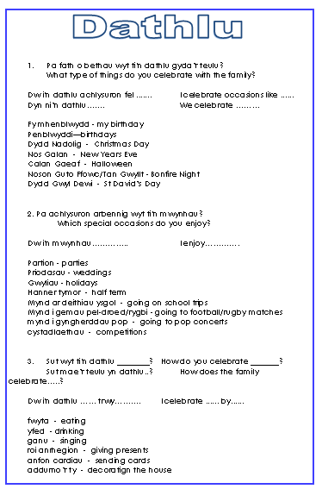
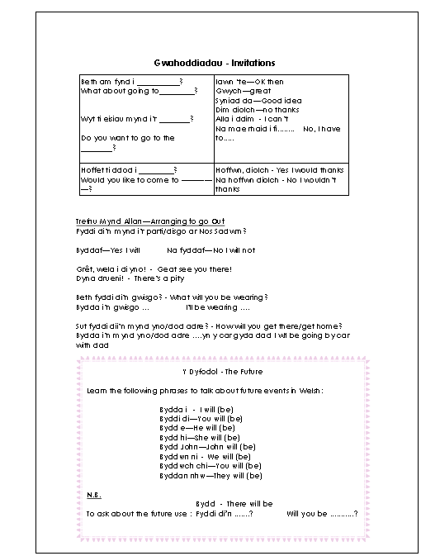
Mapio iaith ar draws yr uned:

Slide 3
Cyflwyno gwybodaeth: Y presennol: Cerdyn cymorth
Dw i’n …+ berf
hoffi / mwynhau / dwlu ar /gallu / mynd/ bwyta /yfed/dathlu /rhedeg/gwisgo
Mae ci bach brown
‘da fi
Ydy
Oes
Mae e’n / Mae hi’n…+berf
hoffi / mwynhau / dwlu ar /gallu / mynd/ bwyta /yfed/dathlu / rhedeg/gwisgo
Mae ci bach brown
‘da fe
Mae ci bach brown
‘da hi
Ydy e’n … / Ydy hi’n…+berf
hoffi / mwynhau / dwlu ar /gallu /dathlu. mynd/ bwyta /yfed /rhedeg/gwisgo?
Oes anifail anwes
‘da fe / da hi?
Nag oes
Dydy e ddim yn …/ Dydy hi ddim yn…+berf
hoffi / mwynhau / dwlu ar /gallu / mynd/ bwyta /yfed/dathlu /rhedeg/gwisgo
Does dim ci bach brown
‘da fe
Does dim ci bach brown
‘da hi
Nac Ydy

Slide 4
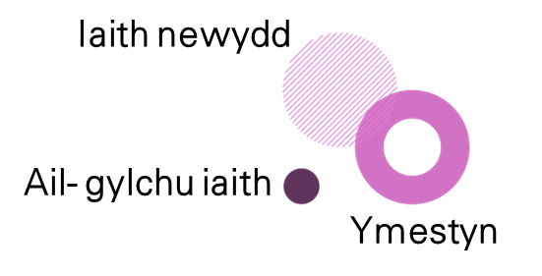
Pa iaith sydd angen nesaf? Parhau gyda’r cylch adeiladu iaith ar ôl ymarfer y patrymau iaith. Pa iaith sydd angen nesaf?
Cam 2: Defnyddio'r iaith gyda chymorth

Slide 5


Enghraifft: Dathlu: Ymestyn
Iaith newydd
Ail- gylchu iaith
Pa fath o bethau wyt ti'n dathlu gyda’r teulu?
Ymestyn
Dw i'n dathlu achlysuron fel ....... Dyn ni’n dathlu……. Fy mhenblwydd - my birthday Penblwyddi—birthdays Dydd Nadolig - Christmas Day Nos Galan - New Years Eve Calan Gaeaf - Halloween Noson Guto Ffowc/Tan Gwyllt - Bonfire Night Dydd Gwyl Dewi - St David’s Day
Drilio

Slide 6
Enghraifft: Dathlu: Ail gylchu/ Ail ymweld
Iaith newydd
Ail- gylchu iaith
Pa fath o bethau mae e/hi/nhw’n dathlu gyda’r teulu?
Ymestyn
Mae e’n dathlu… Mae hi’n dathlu… Maen nhw’n…. Fy mhenblwydd - my birthday Penblwyddi—birthdays Dydd Nadolig - Christmas Day Nos Galan - New Years Eve Calan Gaeaf - Halloween Noson Guto Ffowc/Tan Gwyllt - Bonfire Night Dydd Gwyl Dewi - St David’s Day
Drilio

Slide 7
Gellid gwau gemau Cam 1 gyda cham 2 er mwyn creu gwers
Drilio
Defnyddio’r iaith : chwarae gemau ac ymarferion byr
Yn fwy annibynnol
( cam 1)
Gyda chymorth
(Cam 2)

Slide 8

Gemau : Copio cyflym
Sut i chwarae. How to play:
Careful copying:
Yn y gêm rhaid i chi ysgrifennu brawddeg yn ofalus.
In this game, you must copy a sentence carefully as many times as you can in a minute. The winner is the person who has copied the most times.
Focus:
.

Slide 9

Gemau : Un pen un dis
Sut i chwarae. How to play
One pen one dice​
Pupils work in pairs with one pen or pencil and 1 dice. Whoever rolls the highest number is handed the pen and will start copying a short text in Welsh or a list of chosen sentences from the sentence builder. The other person rolls the dice until he /she gets a 6. Then they can swap the dice for the pen and begin copying on their page. The winner is the person who finishes copying the text first.
Interactive dice

Slide 10
Gemau : Beth ydy’r gwahaniaeth?
Sut i chwarae. How to play:
What’s the difference:
Spot the missing details / spot the differences​
Write a text in Welsh using sentences from the sentence builders. Read aloud or record yourself reading the text. Create a gap fill exercise based on your text making sure that you have a variety of key patterns and vocabulary as gaps. The words / phrases needed to fill the gaps should be available at the bottom of the page for pupils.
Focus:
Sgiliau Gwrando/ listening skills

Slide 11
Gemau : Lleidr brawddegau
Sut i chwarae. How to play:
Sentence steeler:
Focus:
Sgiliau Gwrando/ listening skills
Copy a sentence from the sheet on to a post it note. Don’t show any one!
Walk around the class. Read a sentence to a classmate.
If you have a matcher you steal their sentence. The person with the most sentences win!

Slide 12
Parhau gyda’r cylch adeiladu iaith ar ôl ymarfer y patrymau iaith neu symud at gam 3?
Symud at gam 3?

